Slide 1


V. T. Patel Department of
Electronics and Communication Engineering
EC346 GROUP PROJECT-I
Surveillance Updates On Email Using Raspberry Pi
MADE BY:
Amartya Singh(17EC088)
17ec088@charusat.edu.in
MADE BY:
Rahul Thakkar(17EC094)
17ec094@charusat.edu.in

Slide 2
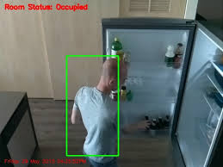
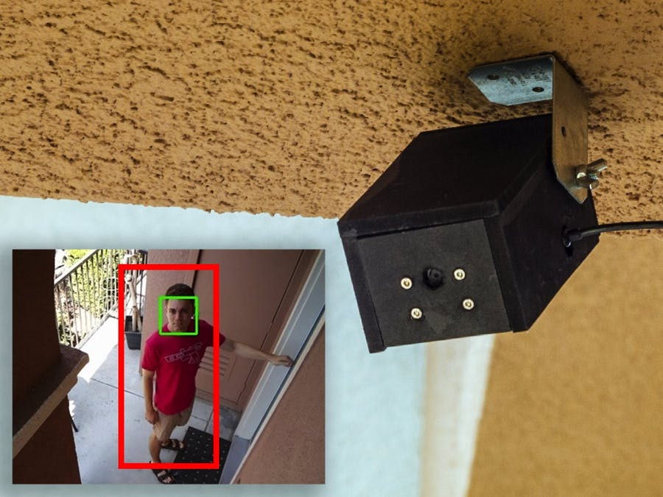
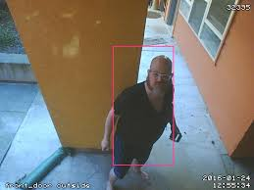
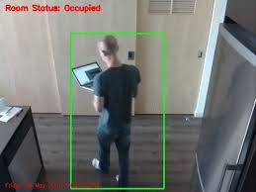
Brief
This security camera on detecting an object will send an Email to the administrator with the pictures of the detected object. Administrator can also watch live streaming of camera from any device that is capable of running any browser

Slide 3

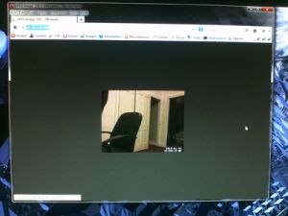
FEATURES
✓ Object Detection
✓ Sends an Email with an image of detected object
✓ Live Streaming on any device with a browser

Slide 4


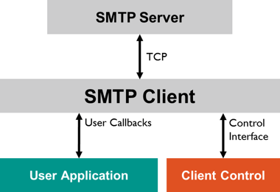
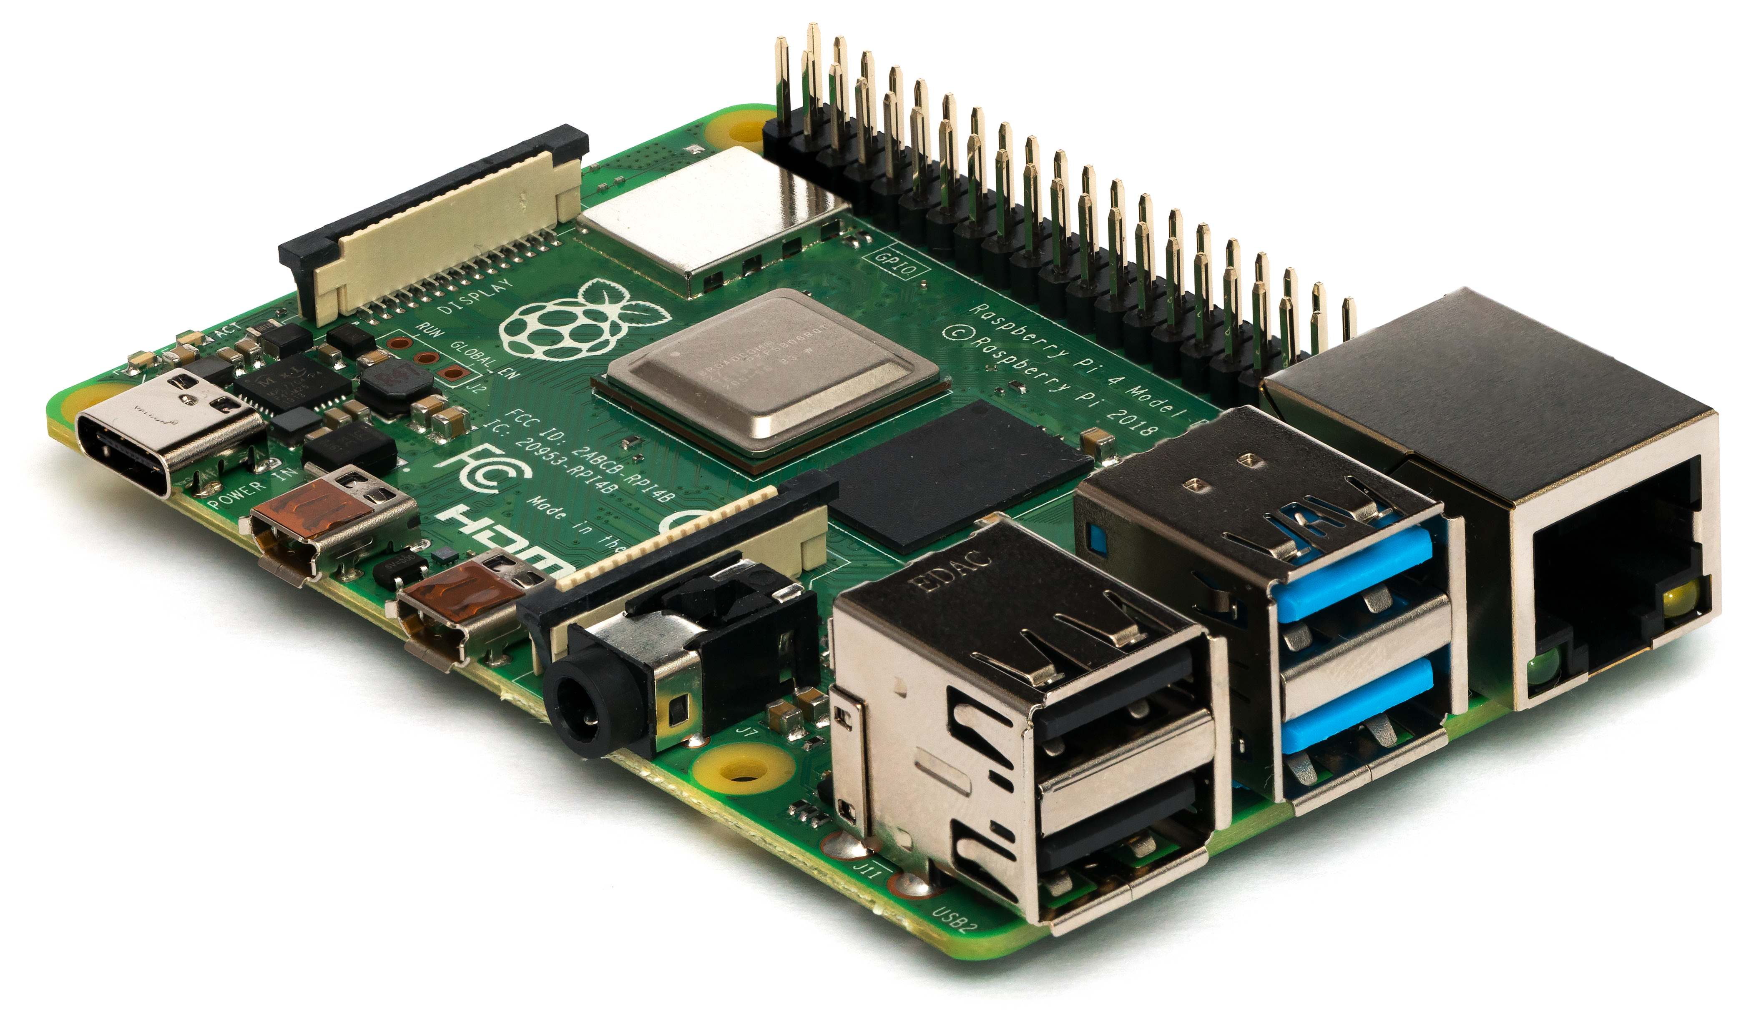
Skills Required
Python
OpenCV
Raspberry PI
SMTP (Simple Mail Transfer Protocol) Configuration
IP configuration
Hardware Assembly & Casing

Slide 5
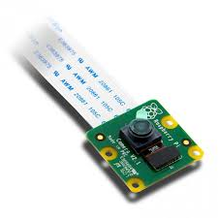
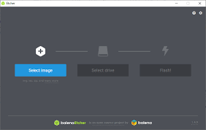
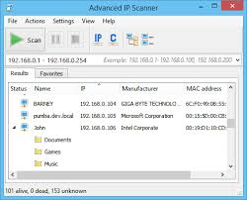
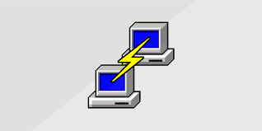
Requirements
Hardware Required:
Raspberry Pi 3
PI Camera
Pi Camera Cable
Micro-USB to USB cable
Casing
Power supply adapter
micro-SD card
SD card Adapter.
Software Required:
Open CV
Python
Raspbian OS
Any other OS like windows / ubuntu
Any browser
SMTP interface
IP configuration tool
VNC Display
PUTTY
Advanced IP scanner
Etcher

Slide 6
Application with Pros & Cons
Application:
✓ Intruder / Pet / Baby monitoring system
✓ Wildlife photography
Advantages:
✓ No need of continuous monitoring
✓ On detecting Object pictures are provided on Email
✓ Live Streaming on any device
Disadvantages:
✓ Picture quality is not great
✓ Not good for low light conditions
✓ Latency & frame drops during live streaming

Slide 7
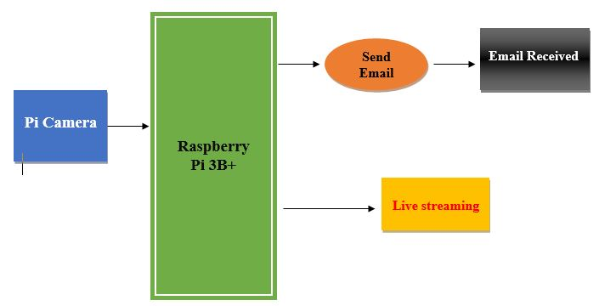
Block Diagram

Slide 8
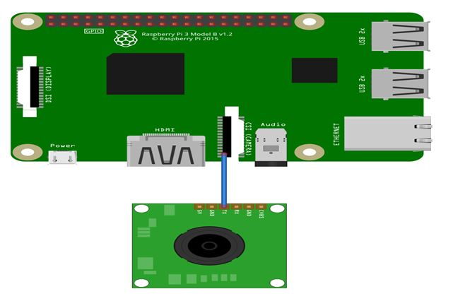
Schematic Diagram

